Slide 1

Anomaly detection in vessel traffic
A SAAB production

Slide 2
Last Week
Data exploration
Correlation Matrix
Data sanitizing - difficult
Rnn research
For later
Literature review – finished
Datacamp - finished

Slide 3
The Data!!!

Slide 4
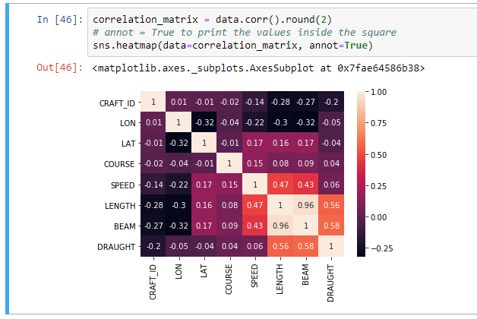
Cool stuff
Correlation Matrix
Column names
Lower numbers -> negative relation

Slide 5
This week
Data sanitizing
Look into classification algorithms
Waypoint clustering

Slide 6
Questions?

